Slide 1

BANK MANAGEMENT SYSTEM
GOVERNMENT AUTONOMOUS COLLAGE, ROURKELA
(SUNDARGARH, RAGHUNATHPALI, ROURKELA, ODISHA)
SUBMITTED BY:-
19CSC016 - SEEMA EKKA
19CSC024- EKTA BHENGRA
19CSC050- LIPIKA MAHAPATRA
19CSC047- SANKARSHAN PRADHAN
SRI JAYANTA KUMAR SAMNATRAY
ALGORITHM, SOFTWARE ENGINEER &
DEVELOPER.
GUIDED BY:-

Slide 2
INTRODUCTION
A bank is a commercial or state institution that provides financial services, including issuing money in form of coins, banknotes or debit cards, receiving deposits of money, lending money and processing transactions.
A commercial bank accepts deposits from customers and in turn makes loans based on those deposits.
Currently in most of jurisdictions commercial banks are regulated and require permission to operate.
In today’s world the way of functioning and managing the system has been totally changed. There is a sudden and abrupt changes in the structure, maintenance and modification, handling, levelling inside every system.
Without managing system through computer applications and programming, the development of infrastructures are unfinished.

Slide 3
OBJECTIVE
Co-ordinate elements of banking activity with a view to generating profits.
Ensures an optimal and organic system of interaction of those elements.
Keep money safe for customers.
Offer customers interest on deposits, helping to protect against money losing value against inflation.
Lending money to firms, customers and homebuyers.
Offering financial advice and related financial services, such as insurance.

Slide 4
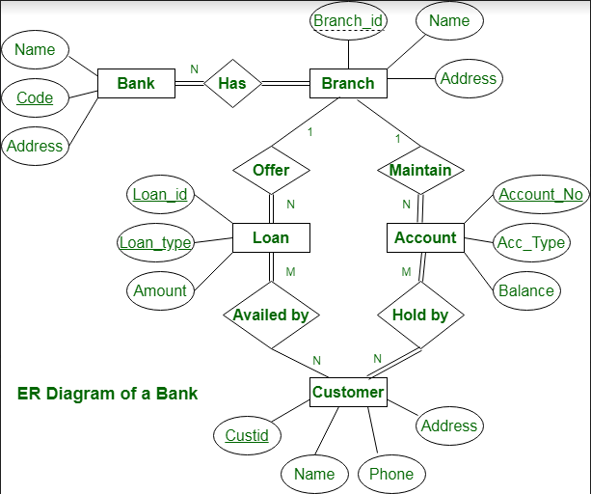
E -R DIAGRAMS

Slide 5
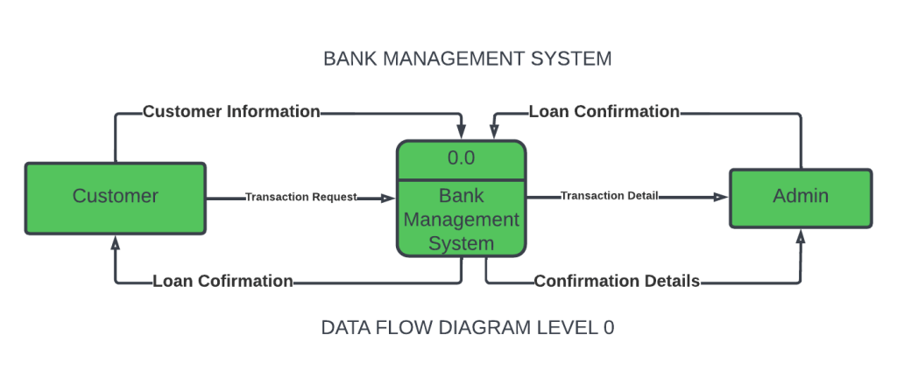
DATA FLOW DIAGRAM

Slide 6
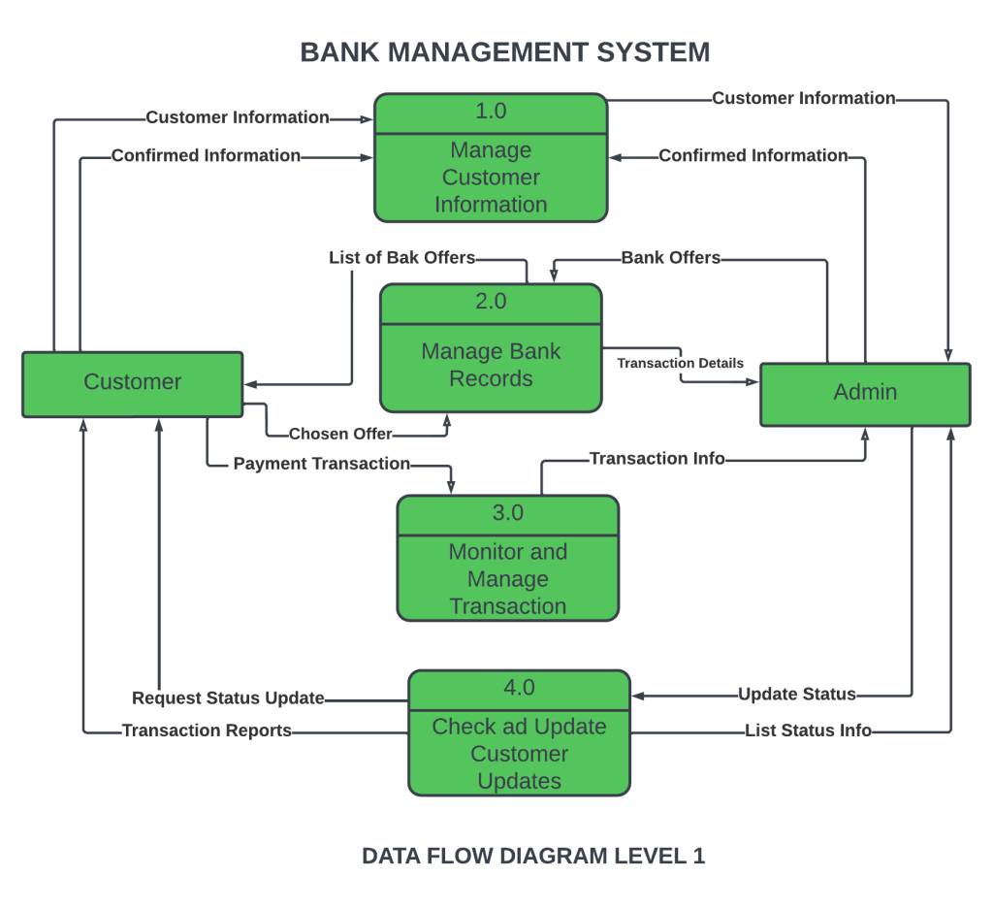

Slide 7
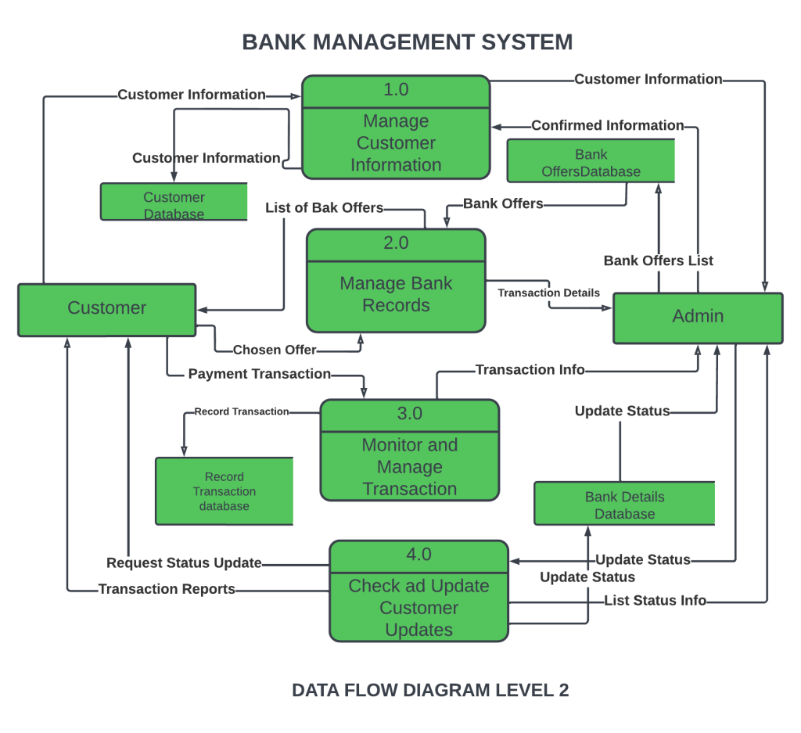

Slide 8
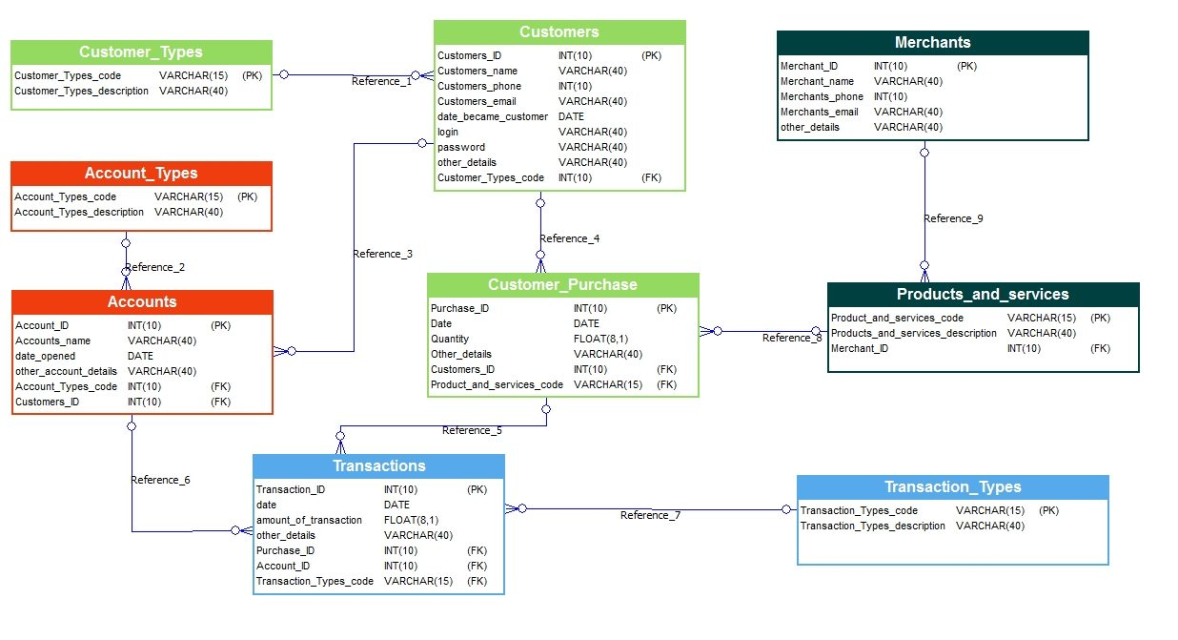
Data Dictionary: -

Slide 9
CONCLUSION:
There are many advantages of using this program as it contains various features like. It is actually a user-friendly software as it is just easy to use by just following the instruction which are appeared on the screen.
This program needs user account number to access user information, so that only authorized users are only allowed to access through the internal main system.
Once a record has been saved, duplicate record can’t be made. All the record has different account so that there will not be any misplace of the records entered.

Slide 10
THANK YOU

